Slide 1
INT222 - Internet Fundamentals
Week 1: Internet Architecture and Introduction to JavaScript

Slide 2
Agenda
Course introduction
Internet architecture
Web client-side programming
Basic introduction to JavaScript

Slide 3
Course Overview
Course outline
https://scs.senecac.on.ca/course/int222
Course standards
https://scs.senecac.on.ca/~wei.song/int222/int222.html#standards
Academic Honesty Policy
https://scs.senecac.on.ca/page/academic-honesty-policy
In this course, you will learn web client side (front-end) development concepts and techniques, including JavaScript, HTML, CSS, and DOM

Slide 4
Course Overview
No text book.
Reference material:
Mozilla Developer Network (MDN) start page
by the Mozilla Developer Network and individual contributors
http://developer.mozilla.org
Web Education Community Group Wiki
by the W3C Web Education Community Group
http://www.w3.org/community/webed/wiki/Main_Page
Your Web, Documented
by the W3C and the Web Platform stewards
http://www.webplatform.org/

Slide 5
Course Overview
Lecture notes, labs and assignments will on my website:
https://scs.senecac.on.ca/~wei.song/
Tests & Quizzes
2 term tests are scheduled in week 6 and week 11.
3 quizzes are not pre-announced. No make-up for quizzes.
Labs and assignments
Late penalties: 10% for first day, and 5% for each subsequent day to a maximum of 14 days.
Grades will be posted on Blackboard

Slide 6
Evaluation
6 labs (1 % or 2% each) 10%
3 quizzes (1.5% or 2% each ) 5%
3 assignments (6% + 6% + 8%) 20%
2 term tests (17% + 18%) 35%
Final exam 30%
--------------------------------------------------------
Total 100%

Slide 7
Promotion Policy
To obtain a credit in this subject, a student must:
Achieve a grade of 50% or better on the final exam
Satisfactorily complete all 3 assignments
Achieve a weighted average of 50% or better for the tests and final exam
Achieve a grade of 50% or better on the overall course

Slide 8
How to Get an A in this Course
Attend all lectures and labs.
Take your own notes
Ask question if you don’t understand.
Complete labs, assignments on time.

Slide 9
Expectation
Mine:
Be present. Be organized/don’t fall behind.
Be active in class/labs.
Read not only the lecture notes.
Learning strategy:
Getting the big picture (concepts, framework, architecture)
paying attention to the details (coding, syntax, hands-on)
Thinking, practicing and memorizing!
Yours?
Notes:
Teaching and learning are two-way communication.
Your attention, cooperation, and feedback help my teaching and your learning.

Slide 10

Communication
Blackboard /
Announcements, marks, …
My web site:
https://scs.senecac.on.ca/~wei.song/
Email:
wei.song@senecacollege.ca
Student help hours:
http://scs.senecac.on.ca/~wei.song/#timetable
Office room: Tel -2099

Slide 11
INT222 Zenit Account
Your instructor will issue each student registered in the INT222 course an account/password on zenit.senecac.on.ca for submitting your labs and assignments.
zenit.senecac.on.ca is a secure Linux server running an Apache web server.
Your account on zenit has sftp and SSH access.
The account and password can be found in the Grade section of the Blackboard.
You must abide by all the rules and regulations set forth in the "Seneca College Acceptable Account Use Policy".
Sharing your username/password with others will be considered an act of cheating.
Secure your account and don’t change the password.

Slide 12

Internet Architecture
The internet is a collection of networks connected to each other. The networks are connected together to form the single entity that we know as the Internet.
The Internet architecture is described in its name, a short form of the two words - interconnected networks.
Notes:
http://tech.faadooindians.com/internet/internet-architecture/
the Internet architecture is by definition a meta-network, a constantly changing collection of thousands of individual networks intercommunicating with a common protocol.

Slide 13
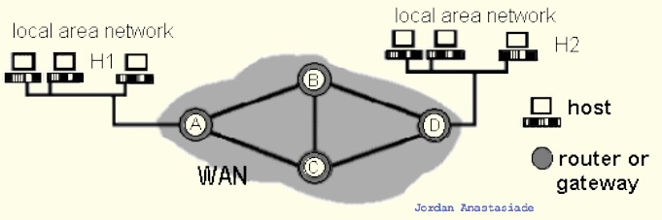
Elements of Networks
Communication links:
point-to-point (e.g., A-to-B)
broadcast (e.g.,: Ethernet LAN)
Host: computer running applications which use network (e.g. H1)
Router: computer routing packet from input line to output line. (e.g. C)
Gateway : a router directly connects networks (e.g. A)

Slide 14
Internet Protocol Suite
Communications protocol
a formal description of message formats
the rules for exchanging those messages
Internet Protocol Layers
Application layer (e.g. HTTP, FTP, Telnet, SMTP, DNS)
Transport layer
TCP (Transmission Control Protocol),
UDP (User Datagram Protocol)
Applications that do not require the reliability of a connection
Network layer : IP (Internet Protocol)
Physical and data link layers
e.g. Ethernet, token ring

Slide 15
Internet Application Protocols
Remote login category
Telnet
SSH, Secure Shell
File transfer category
FTP, File Transfer Protocol
SFTP, Secure File Transfer Protocol
Support services category
DNS, Domain Name System
SNMP, Simple Network Management Protocol
CMOT, Common Management Information Protocol
Electronic mail category
SMTP, Simple Mail Transfer Protocol
IMAP, Internet Message Access Protocol
POP, Post Office Protocol
Other protocols
HTTP, HyperText Transfer Protocol
HL7, Health Level Seven
LDAP, Lightweight Directory Access Protocol
NFS, Network File System
DHCP, Dynamic Host Configuration Protocol
IRC, Internet Relay Chat
…

Slide 16
Services Provided by the Internet
World Wide Web
Abbreviation: WWW or W3,
Commonly known as the Web.
It is a collection of web pages connected through hyperlinks and URLs.
With a web browser, one can view web pages that may contain text, images, videos, and other multimedia and navigate between them via hyperlinks.
It is governed by the Hyper Text Transfer Protocol (HTTP) that deals with the linking of files, documents and other resources of the web.
Other services:
Electronic Mail (email), Mailing List, File Transfer Protocol (FTP), Instant Messaging, News Groups, Chat Rooms
Notes:
http://www.slideshare.net/waqarbutt74/services-provided-by-the-internet-13135007

Slide 17
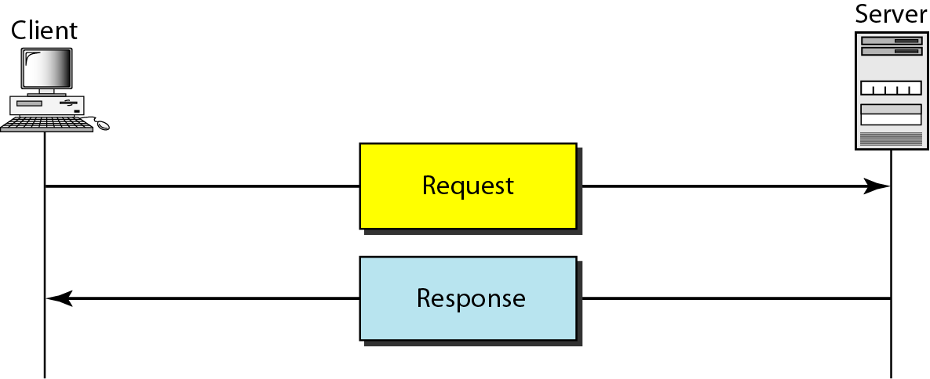
Client Server Model
The www uses a client-server model
client software (web browser) requests an html page
the request is sent as a message to the particular web server
requested page is sent as a message from the server to the client
the client software interprets and displays the html page

Slide 18
Uniform Resource Locators (URL)
Also known as a web address. It is a reference (an address) to a resource on the Internet.
https://scs.senecac.on.ca:443/~wei.song/index.html#timetable
protocol = https://
domain / host = scs.senecac.on.ca
port = 443, default for HTTPS
file / resource ID = ~wei.song/index.html
reference = #timetable
URLs are typically transmitted via HTTP

Slide 19
DNS (Domain Name System/Server)
DNS is used to give names to IP addresses. DNS servers (name servers) associate the domain names with the IP address
e.g.
zenit.senecac.on.ca is used to identify IP address 142.204.140.203.
In addition to ".ca", other common domains include
.com - commercial
.edu - educational
.gov - governmental
.net - isp
.org - non-profit
and many more
ICANN - Internet Corporation for Assigned Names and Numbers- oversees assignment of names and IP addresses and certifies domain name registrars to manage the process.

Slide 20
Hypertext Transfer Protocol
HTTP, the Hypertext Transfer Protocol, is the application-layer protocol that is used to transfer data on the (World Wide) Web.
HTTP comprises the rules governing the format and content of the conversation between a web client and server.
HTTP functions as a request-response protocol in the client-server computing model.
It follows a classical client-server model, with a client opening a connection, making a request then waiting for a response until it receives it.
HTTP is stateless.
The server doesn't keep any data (state) between two requests.
Notes:
The Hypertext Transfer Protocol (HTTP) is an application protocol for distributed, collaborative, hypermedia information systems.[1] HTTP is the foundation of data communication for the World Wide Web.
The Hypertext Transfer Protocol (HTTP) is an application protocol for distributed, collaborative, hypermedia information systems.[1] HTTP is the foundation of data communication for the World Wide Web.
Hypertext is structured text that uses logical links (hyperlinks) between nodes containing text. HTTP is the protocol to exchange or transfer hypertext.
The standards development of HTTP was coordinated by the Internet Engineering Task Force (IETF) and the World Wide Web Consortium (W3C), culminating in the publication of a series of Requests for Comments (RFCs), most notably RFC 2616 (June 1999), which defines HTTP/1.1, the version of HTTP in common use.

Slide 21
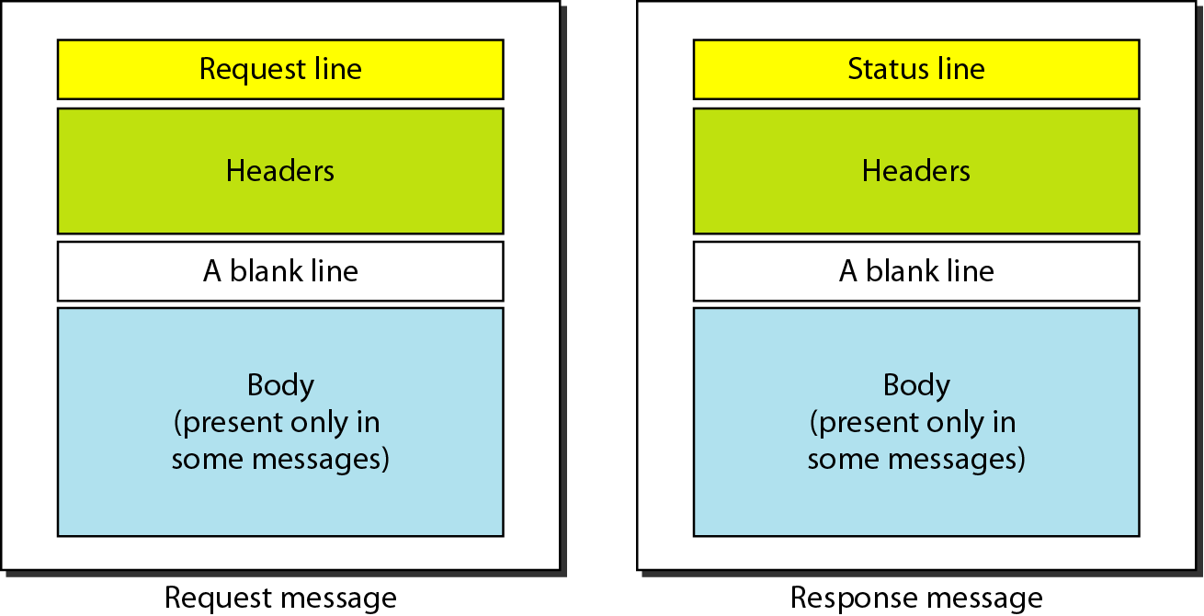
HTTP Request and Response Messages

Slide 22
HTTP Request
HTTP request example: sending the form result to a server:
POST /contact_form.php HTTP/1.1
Host: developer.mozilla.org
Content-Length: 64
Content-Type: application/x-www-form-urlencoded
name=Joe%20User&request=Send%20me%20one%20of%20your%20catalogue
HTTP request methods
GET, POST
PUT, DELETE, HEAD, TRACE

Slide 23
HTTP Response
HTTP response example: successful reception of a web page:
HTTP/1.1 200 OK
Date: Sat, 09 Oct 2010 14:28:02 GMT
Server: Apache
Last-Modified: Tue, 01 Dec 2009 20:18:22 GMT
ETag: "51142bc1-7449-479b075b2891b"
Accept-Ranges: bytes
Content-Length: 29769
Content-Type: text/html
<!DOCTYPE html... (here comes the 29769 bytes of the requested web page)
HTTP Response Status Codes
1xx - information
2xx – success. e.g. 200 = request succeeded.
3xx - redirection
4xx – client error. e.g. 403 = forbidden page
5xx – server error. e.g. 500 = internal server error.

Slide 24

HTTP Secure
Hypertext Transfer Protocol Secure (HTTPS) is a communications protocol for secure communication over a computer network, with especially wide deployment on the Internet.
Technically, it is not a protocol in and of itself; rather, it is the result of simply layering the HTTP on top of the SSL(Secure Sockets Layer) / TLS(Transport Layer Security) protocol, thus adding the security capabilities of SSL/TLS to standard HTTP communications.

Slide 25
Standards & the World Wide Web Consortium (W3C)
The World Wide Web Consortium (W3C):
main international standards organization for the World Wide Web.
in order to continue the development of the web, and its languages
Founded: October 1994
Founder: Tim Berners-Lee

Slide 26
Web Application
A web application or web app:
A distributed application that uses Web-based technologies (and generally relies on Web browsers for the presentation of user-interfaces) is typically considered a Web application.
Update and maintain web applications without distributing and installing software on potentially thousands of client computers
inherent support for cross-platform compatibility.
Common web applications include:
Webmail, online retail sales, online auctions, wikis and more…

Slide 27
Front-end Web Application
The rising popularity of so-called “modern” web apps means that web developers are focusing on writing more and more front-end, or client-side code.
Although back-end, or server-side code still plays an important factor, the fact is that web developers are working more directly with HTML5, CSS3, JavaScript and the DOM.
Notes:
server-side usually consists of three parts: a server, an application, and a database

Slide 28
Front-end Web Application
The four pillars of front-end web development:
HyperText Markup Language (HTML5)
The main language for creating web pages
Content and structure of the Document
Cascading Style Sheets (CSS)
Used for describing the appreance and formatting of a web page
Presentation or style web pages
JavaScript (JS)
Allows client-side scripts to interact with the user
Behavior and State of the frontend
Document Object Model (DOM)
2-way programming API for JavaScript

Slide 29
Front-end Web Apps Demos
The Planetarium
Beautiful Web Introduction to the solar system
BananBread
Web FPS shooter
CSS Tricks
Web Animation (using data from 3d body tracking)
Responsive Web Application
For multi-media types:
Screen (mobile, desktop), print, projection, tty, …
Notes:
FPS – first person

Slide 30
Let’s start with JavaScript

Slide 31
Firefox Developer Tool: Scratchpad
Why use Scratchpad?
JavaScript always runs inside a host environment (mostly the browser).
Starting Scratchpad
Go to the “Web Developer” menu. Then select “Scratchpad” from that menu, and you’ll get a text editor window.
Hint for Mac users: look for the “Web Developer” menu under “Tools”.
Shortcut: Shift+F4
More on Developer tools:
Firefox developer tools
Chrome developer tools
JSLint – JavaScript code analysis tool
JSFiddle - an online playground for web developers
Notes:
A Word about Scopes
When you run code in Scratchpad, it runs in a sandbox that has access to everything on your page, but keeps you from accidentally leaking variables onto your page. This is very similar to how the Web Console works. If you want to put a variable onto your page, just set it on window. window.foo=1 will give your page a variable foo that is accessible to scripts on the page.
Scratchpad, unlike Web Console, follows you around as you switch tabs. When you execute code, it runs against the current tab in your browser. This makes it easy to try the same code against your development and staging servers, for example.
Trying New Code with Scratchpad
Scratchpad is a great way to try out code in a live browser environment. For example, imagine you have a function called calculatePosition, and it’s just not working quite right. Load up your page, copy the function into Scratchpad and type out a couple lines of code that make use of calculatePosition. You very quickly get into a flow of tweaking the function and re-running the code.
Once you have the result you want, just copy the code back into your main file. This whole time, you didn’t have to reload the page even once.

Slide 32
Scratchpad
How to run a script:
Enter some code
Select a portion of the code
Choose one of the three commands from the Execute

Slide 33
Input and output
JavaScript does not include input and output facilities. Its host environment (e.g. a browser) provides 3 popup Boxes (Modal windows) :
alert()
prompt()
confirm()
as well as
console.log()

Slide 34
alert()
Alert box, popups a modal window, and user need to click on “OK” to continue.
Outputs info.
Example code:
window.alert(“Welcome to INT222!”);
Same as:
alert(“Welcome to INT222!”);

Slide 35
confirm()
Confirm box, needs user to verify or accept something.
Returns a boolean value: true or false
Example code:
var result = confirm("Are you OK?");
if (result) {
alert("You pressed OK!");
} else {
alert("You pressed Cancel!");
}

Slide 36
prompt()
Prompt box, displays a dialog box (Modal window) that prompts the user for input.
Returns a string entered by the user input; or return the value null.
Example code:
var cl = prompt("Enter your favorite color", "green");
if (cl != "") {
alert(cl);
}
if(!cl) { // JavaScript Falsy
alert("No color entered.")
} 1+2; // Inspect/display executes the selected code,
//and prt the result right into your editor.

Slide 37
console.log()
Shows a message in web console.
Outputs info.
Example code:
var anObject = { str: "Some text", id: 5 };
console.log(anObject);
View log:
Ctrl + Shift + J to open browser console.
Notes:
Firefox:
Web console contains browser console
The console is also where the browser writes error messages. It writes them there so that the muggles won't see them and worry about them, but the wizards and witches of the web (such as yourselves) can easily see them. As of this writing, here's how you can find them:
Firefox: Tools > Web Developer > Error Console. Or, much easier, use the keyboard shortcut: command-shift-J on a Mac.
Safari: Develop > Show Error Console. Or, use the keyboard shortcut: option-command-C
Chrome: View > Developer > JavaScript Console. Or, use the keyboard shortcut: option-command-j

Slide 38
Introduction to JavaScript
JavaScript (sometimes shortened to JS) is a lightweight, interpreted, high-level language used along with html code.
The language syntax is somewhat similar but not the same as the C language. Today, JavaScript is the scripting language for Web pages.
JavaScript is not Java
An interpreted language interprets and executes each statement - one-by-one - in the order they appear.
JavaScript always runs inside a host environment (mostly the browser).
Notes:
A high-level programming language that is interpreted by another program at runtime rather than compiled by the computer's processor as other programming languages (such as C and C++) are.
Scripting languages, which can be embedded within HTML, commonly are used to add functionality to a Web page, such as different menu styles or graphic displays or to serve dynamic advertisements. These types of languages are client-side scripting languages, affecting the data that the end user sees in a browser window. Other scripting languages are server-side scripting languages that manipulate the data, usually in a database, on the server.
Scripting languages came about largely because of the development of the Internet as a communications tool. JavaScript, ASP, JSP, PHP, Perl, Tcl and Python are examples of scripting languages.

Slide 39
Introduction to JavaScript
Netscape originally developed JavaScript under the name "Mocha" then "LiveScript" and finally renamed to JavaScript.
The JavaScript standard is based on the European Computer Manufacturers Association (ECMAScript). As of 2012, all modern browsers fully support ECMAScript 5.1.
JavaScript is useful for making dynamic web pages, validating user input and changing the way the web page responds to events on the web page.
JavaScript statements can be stored in an external file with a .js file extension or embedded within HTML code.
Notes:
A high-level programming language that is interpreted by another program at runtime rather than compiled by the computer's processor as other programming languages (such as C and C++) are.
Scripting languages, which can be embedded within HTML, commonly are used to add functionality to a Web page, such as different menu styles or graphic displays or to serve dynamic advertisements. These types of languages are client-side scripting languages, affecting the data that the end user sees in a browser window. Other scripting languages are server-side scripting languages that manipulate the data, usually in a database, on the server.
Scripting languages came about largely because of the development of the Internet as a communications tool. JavaScript, ASP, JSP, PHP, Perl, Tcl and Python are examples of scripting languages.

Slide 40
About JavaScript
JavaScript is one of the world's most popular programming languages .
The role as the scripting language of the WWW.
simple and easy to learn
JavaScript is the world's most misunderstood programming language.
The name, typecasting, used by amateurs, object-oriented,…
JavaScript is, in the future, the most important language you will learn(? Dart?)

Slide 41
Basic JavaScript Rules
JavaScript is case-sensitive
When writing a JavaScript script, be aware of upper and lower case characters. CustomerCount is not the same as Customercount nor is it the same as customerCount
JavaScript statement
A JavaScript typically consists of a series of statements. A statement is a single line of instruction to the computer made up of objects, expressions, variables, and events/eventhandlers.
Every statement has the same structure:
A statement starts on its own line (recommended but not required)
The first item in a statement is a command
The second part following the command is some information about that command
The last part of a statement is a terminating semi-colon;
Command block
A Command block is a group of statements that is treated as a single entity and are grouped within braces - the curly brackets - { }

Slide 42
Basic JavaScript Rules
Matching Pairs
Opening and closing symbols need to work in pairs. For example, if you use the left brace { to indicate the start of a command block, then you must use the right brace } to end the command block. The same matching pairs applies to single '......' and double "......." quotes to designate text strings.
The use of white Space
JavaScript ignores extras spaces however it is recommended that you use them to make your scripts easier to read.
The use of comments
While comments are not required as part of the JavaScript language, it is recommended that you include comments in your scripts.
JavaScript uses the symbols /* to designate a comment */
JavaScript also uses the // for short comments.

Slide 43
JavaScript data types
There are 3 main (primitive) data types:
string
must be enclosed in single or double quotes
number
can be integers or floating point
Special number: Infinity, NaN
boolean
values are binary, with the values (1) "true" and (0) "false" (without the quotes)
Other types:
undefined, null, object, function
Notes:
Primitive Data Types: string, number, boolean, undefined, null
Object include function and array, but
typeof(function(){}) // results: function
typeof([]) // relsuts: object

Slide 44
JavaScript data types
JavaScript is a loosely typed language.
You do not have to specify the data type of a variable when you declare it.
Data types are converted automatically as needed during script execution.

Slide 45
JavaScript Variable
Variable naming rules are: Must start with a letter, underscore (_), or dollar sign ($)
Cannot be a reserved (key) word
Subsequent characters can be letters
upper case (A...Z) or lower case (a...z),
numbers
underscores
JavaScript reserved words
Similar to other programming languages, JavaScript has a list of words that are considered "reserved".

Slide 46
Declare and Refer Variables
You must use the "var" keyword to precede a variable name.
Unlike the C language, you do not need a type specifier.
The variable's initial value will set its initial type.
Declaration syntax:
var variableName;
Or:
var variableName = "Summer";
// Referring to and using syntax:
variableName = 2015;
alert(variableName);
Dynamic typing
a JavaScript variable can have a different type in different parts of a program

Slide 47
Variables Example
Declaration | Type | Value
var identOne = "some text"; | String | some text
var identOne = 'some text'; | String | some text
var IdentOne = '172'; | String | 172
var _identOne = 25; | Number (Integer) | 25
var _identTwo = 56.2564; | Number (float) | 56.2564
var ident_A = true; | Boolean | true (1)
var ident_B = false; | Boolean | false (0)
var ident_C; | undefined | undefined
var ident_D="Yes", ident_E="No"; | String / String | Yes / No

Slide 48
Special values
Infinity
Number Data Type
e.g. alert(12/0);
NaN
Number Data Type
null
both a value and a data type
undefined
both a value and a data type
e.g. var x;
alert(x);

Slide 49
Expressions
An expression is any valid set of literals, variables, operators, and expressions that evaluates to a single value.
The value may be a number, a string, or a logical value.
Two types of expressions:
1) those that assign a value to a variable, e.g. x = 7 .
2) those that simply have a value, e.g., 3 + 4 simply evaluates to 7; it does not perform an assignment.
JavaScript has the following kinds of expressions:
Arithmetic - evaluates to a number
String - evaluates to a character string
Logical - evaluates to true or false
49

Slide 50
Conditional Expression
A conditional expression can have one of two values based on a condition. The syntax:
If the condition is true, the expression has the value of val1, Otherwise it has the value of val2.
(condition) ? val1 : val2;
When When
condition True False
var status = (age >= 18) ? "adult" : "minor";

Slide 51
Arithmetic Operators
Operator | Operation | Example
+ | addition of numbers Concatenation of strings | y + x; "INT" + "222"
- | subtraction | x - y;
* | multiplication | x * y;
/ | division | x / y;
% | modulo | x % y; // remainder of x divided by y
++ | post/pre -increment | x = y++; // assign y to x, then increment y (y+=1) x = ++y; //increment y < (y+=1), then assign y to x
-- | post/pre decrement | x = y--; // assign y to x, then decrement y (y-=1) x = --y; // decrement y < (y-=1), then assign y to x

Slide 52
Assigning Values
Operator | Example | Equivalent | For
= | a = b; | a = b; | Numbers, strings, …
+= | a += b; | a = ( a + b); | numbers or strings
-= | a -= b; | a = ( a - b); | numbers
*= | a *= b; | a = ( a * b); | numbers
/= | a /= b; | a = ( a / b); | numbers
%= | a %= b; | a = ( a % b); // divide a by b, // assign remainder to a | numbers

Slide 53
Logical Operators
Given x = 2;
Operator | Operation | Example
&& | Logical AND | (x > 3 && x == 2) is false
|| | Logical OR | (true || x > 10 ) is true
! | Logical NOT | !(x ==2) is false

Slide 54
Other Operators
The typeof operator (for variable or values):
possible return values:
typeof "John" // Returns string
typeof 3.14 // Returns number
typeof false // Returns boolean
typeof [1,2,3,4] // Returns object
typeof {name:'John', age:34} // Returns object
The instanceof operator
Used for objects

Slide 55
Comparison Operators
Operator | Description | Example
== | Equal (The operands are converted to the same type before being compared.) | 1 == 1 is true 1 == "1" is true 1 == true is true 0 == false is true
=== | strictly equal (There is no type conversion.) | 1 === 1 is true 1 === "1" is false 1 === true is false 0 === false is false
!= | not equal (with type conversion) | 1 != 1 is false 1 != '1' is false
!== | not equal (without type conversion) | 1 !== 1 is false 1 !== '1' is true
> | greater than | expr1 > expr2
>= | greater than or equal to | expr1 >= expr2
< | less than | expr1 < expr2
<= | less than or equal to | expr1 <= expr2

Slide 56
Strings and Quotation Marks
Literal strings can be denoted by either single or double quotes, which gives you some flexibility about how to handle awkward situations such as quotation marks inside a string:
Expression | Values
"Let's start with JavaScript" | Let's start with JavaScript
'Not "it"!' | Not "it"!

Slide 57
Concatenation of Strings
The main operation on strings is the concatenation operator, +:
Expression | Value
"INT" + "222" | INT222
"Stephen" + " Harper" | Stephen Harper

Slide 58
Adding Strings and Numbers
x =5+5; alert(x);
x="5"+"5"; alert(x);
x=5+"5"; alert(x);
x="5"+5; alert(x);

Slide 59
Example - Evaluating Expressions
var x = prompt("Enter a number."); x = x + 2; alert ("The value of x is " + x); x = 2 * x; alert("The new value of x is now " + x); x = x + 1; alert("x is now " + x); alert("x divided by 3 is: " + x/3);
evaluating-arithmetic-expressions.js

Slide 60
Programming Constructs
JavaScript execution flow is determined using the following four (4) basic control structures:
Sequential: an instruction is executed when the previous one is finished.
Conditional a logical condition is used to determine which instruction will be executed next - similar to the "if" and "switch" statements in C.
Looping a series of instructions are repeatedly executed until some condition is satisfied - similar to the "for" and "while" statements in C.
Transfer jump to a different part of the code - similar to calling a function in C.
Example: programming-constructs.js

Slide 61
Programming Constructs (1) – Sequence
var a = 3;
var b = 6;
var c = a + b;
alert(c);

Slide 62
Programming Constructs (2) – Selection
Make decisions and perform single or multiple tasks based on the outcome of the decision (true or false).
Types of conditional statements :
if
if / else
switch / case

Slide 63
Conditional Statements
Conditional Statements give JavaScript scripts the ability to make decisions and perform single or multiple tasks based on the outcome of the decision (true or false).
The if-else
expression / condition is in parentheses (expression)
relational operators include: == != > < >= <=
&& (and) and || (or) can be used to create compound conditions
! (not) can be used to invert a condition
the else clause is optional
if statements may be nested
multiple action statements must be enclosed in brace brackets { }

Slide 64
The General Format for an If Statement
The general format for an if / else statement is as follows:
if (expression) {
statement;
}
else {
statement;
}
if (expression) {
statement;
statement;
statement;
}
else {
statement;
statement;
}

Slide 65
The general format for an if / else / if statement:
if (exp-a) {
statement1; // if exp-a is True
}
else {
if (exp-b) {
statement2; // if exp-b is True
}
else {
statement3; // if exp-b is False
}
}
// equivalent to following:
if (exp-a) {
statement1; // if exp-a is True
}
else if (exp-b) {
statement2; // if exp-b is True
}
else {
statement3; // if exp-b is False
}

Slide 66
Example
var grade, mark=prompt("Enter your mark:"); if (mark >= 90) grade='A+'; else if (mark >= 80) grade='A'; else if (mark >= 70) grade='B'; else if (mark >= 60) grade='C'; else if (mark >= 50) grade='D'; else grade="F"; alert("Your grade: " + grade);

Slide 67
Conditional Statement
The switch / case statement:
select one of many blocks of code to be executed.
switch (expression)
{
case 401:
statement1;
break;
case 403:
statement2;
break;
case 407:
statement3;
break;
default:
statement4;
}

Slide 68
Example
var semester = prompt("Enter CPD semester number (1 to 4)"); switch (semester) { case '1': alert("IPC144, ULI101"); break; case '2': alert("OOP244, INT222"); break; case '3': alert("OOP344, INT322"); break; case '4': alert("JAC444, INT422"); break; default: alert("You may have graduated from CPD"); }

Slide 69
Programming Constructs (3) – Iteration
loop - an action that occurs again and again until a certain condition is met.
Continuously check a condition and based on the outcome, either terminate the loop or repeat a set of statements.
Three basic types of loop structures:
The for loop
The for / in loop
The while loop
The do-while loop

Slide 70
Loop Structures
The for loop
e.g.
var days = "The days in september: \n"; for (var ident = 1 ; ident <= 30 ; ident++) { days += ident + "\n"; } alert(days);

Slide 71
Loop Structures
The for in loop
Iterates over the enumerable properties of an object, in arbitrary order. For each distinct property, statements can be executed.
var student = {name:"John", program:"CPD", semester:2};
var str = "Student info:\n\n";
for (var x in student) {
str += x + ": " + student[x] + "\n";
}
alert(str);

Slide 72
Loop Structures
The example of while loop
The example of do...while loop
var text = ""; var i = 0; while (i < 10) { text += "\nThe number is " + i++; } console.log(text);
var i=10; do { alert("week " + i++); } while (i<15)

Slide 73
Break Statements
Break the loop and continue executing the code that follows after the loop (if any).
Break the current loop and continue with the next value. (nested loops).
var i=1;
while (i<5) {
alert("week "+i);
if (i==3)
break;
else
i++;
}
var i=1, j=1;
while (i<5) {
alert('week: '+i );
for (j=1; j<=7; j++){
alert('day:'+ j +'of week:'+ i);
if (j==3) break;
} // for
i++;
} // while

Slide 74
Resourceful Links
Mozilla Developer Network (MDN) start page
by the Mozilla Developer Network and individual contributors
http://developer.mozilla.org
Web Education Community Group Wiki
by the W3C Web Education Community Group
http://www.w3.org/community/webed/wiki/Main_Page
Your Web, Documented
by the W3C and the Web Platform stewards
http://www.webplatform.org/

Slide 75
Thank You!

